Slide 1
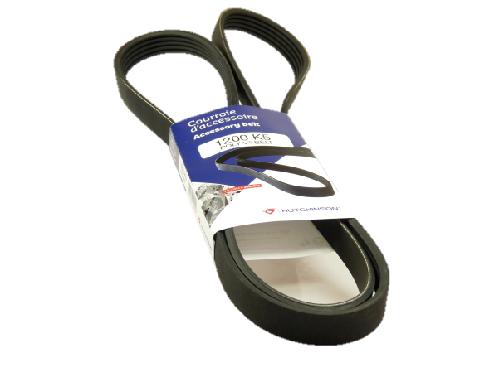
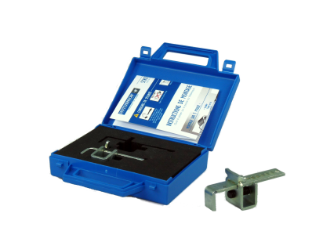
N° 003 11/2015
Automotive spare parts
Rechange automobile
The stretchy Poly V belts
Stretchy Poly V belts equips 20% of new cars registered, and it will increase to 30% in a few years.
Hutchinson has been the first OE supplier to propose a stretchy Poly V on the Ford Focus in 2000.
The advantages of the Hutchinson’s stretchy Poly V belts :
‣ A belt tension that remains stable on long term, thanks to a specific and patented cable
‣ An easy fit with a lower initial strength to be provided during the installation
‣ Less risks of damage on tensioners/idlers and pulleys, due to a lower strengtht applied during installation.
The stretchy poly V belts need the use of specifical tool (reference XK020)
By choosing Hutchinson’s stretchy Poly V belts you get:
An original product
The insurance to have a product easy to fit

